Slide 1
ADVENTURE WORKS
Sales distribution ANALYSIS

Slide 2
Problem statement
Adventure Works faces challenges in maximizing its sales potential due to insufficient understanding of intricate sales patterns, nuanced customer behavior, and diverse product performance. The current analytical approach lacks depth, failing to uncover hidden correlations and predictive trends that could significantly enhance decision-making.
This project seeks to conduct a comprehensive analysis of sales data, customer demographics, and product details to uncover complex relationships and provide sophisticated insights. These insights will facilitate the development of more effective sales strategies, refined product offerings, and targeted marketing campaigns, ultimately driving sustained growth and customer satisfaction.

Slide 3
OBJECTIVES
Analyze product performance and trends, including product lifecycle and sales distribution
Analyze sales performance across different territories to identify high and low-performing regions.
Evaluate the impact of external factors (e.g., economic conditions, marketing campaigns) on product and territory performance.
Perform hypothesis testing to confirm or reject the declared hypotheses using appropriate statistical methods.
Conduct advanced statistical analysis to understand relationships between variables (e.g., regression analysis, correlation analysis).
Interpret statistical results and provide actionable insights based on findings.

Slide 4
DATA INFORMATION
An Adventure Works database containing 7 datasets with details about Sales, Products, Customers, Returns, Categories, Subcategories, Territories and a Calendar, was created
The data has a time duration of 30 months; From the January, 2015 to June 2017
The Sales data has 56046 entries
There are no missing values in the datasets
We converted all date data to datetime format

Slide 5
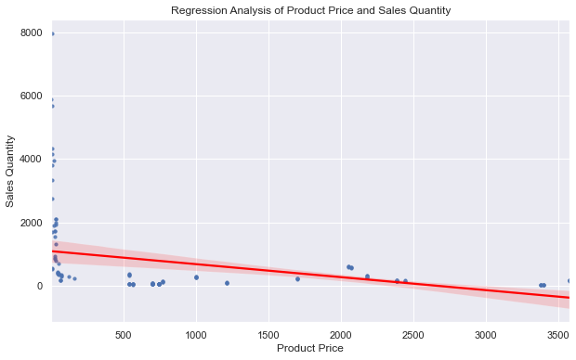
Hypothesis 1: Higher product prices correlate with lower sales quantities.
Pearson Correlation: -0.3630292079645786
P-value: 2.1865231911233115e-05
The correlation value indicates a moderate negative correlation. This means that even though Hypothesis 1 as stated above, is true, the relationship is not strong. There are possibly other factors affecting sales performance.
The P-Value is much less than 0.05; this shows that the correlation is statistically significant

Slide 6
Product Price and Sales Quantity showed a negative correlation; -0.36302920796457844. This means as price increases, quantity decreases.
we can also see that the correlation isn't so high, which shows that the (negative)relationship is not strong.
There is a concentration of points at lower price ranges (Prices below 500) with very high sales quantities. This suggests that lower-priced products have been sold in much larger quantities compared to higher-priced products.
For prices above 500, especially above 1500, the sales quantities drop significantly.
Products priced higher than 2000 have generally lower sales quantities (closer to 0).
Even though most products in the higher price range (above 1500) have low sales quantities, there are a few outlying points indicating moderate sales quantities in the higher price range.
The shaded red area around the regression line represents the confidence interval, showing the uncertainty around the regression line. There is more variation in the data at lower prices.
The high concentration of products with low prices and high sales quantities suggests that the business might be more reliant on high-volume, low-price items. High-priced products are relatively scarce in the dataset and typically have lower sales.

Slide 7
HYPOTHESIS 2; SALES PERFORMANCE VARIES SIGNIFICANTLY ACROSS DIFFERENT TERRITORIES
 | F-Statistic | P-Value
Order Quantity | 25.767187458765147 | 8.18132170981414e-45
Profit | 91.04135321627396 | 2.652068005790242e-169
ANOVA tests were done to determine sales performance across the territories using both the variables "Order Quantity" and "Profit".
For Sales Quantity: The results show small but significant difference in order quantity across the territories being compared. The P-value which is much smaller than the common threshold of 0.05, shows that the variation among the territories is not due to random chance.
For Profit: The result showed a much higher F-statistic compared to the order quantity test, which indicates a stronger distinction among the mean profits of the various territories. The p-value is practically zero, indicating a highly significant result. We can infer that the differences in profit across the territories are highly significant, this means that the variation in profit is not due to random fluctuations.
These results suggests that the various territories are influencing profit even more strongly than they influence order quantity. They also infer that there are underlying patterns or indicators that are causing the significant differences in both sales and profit among the territories.

Slide 8
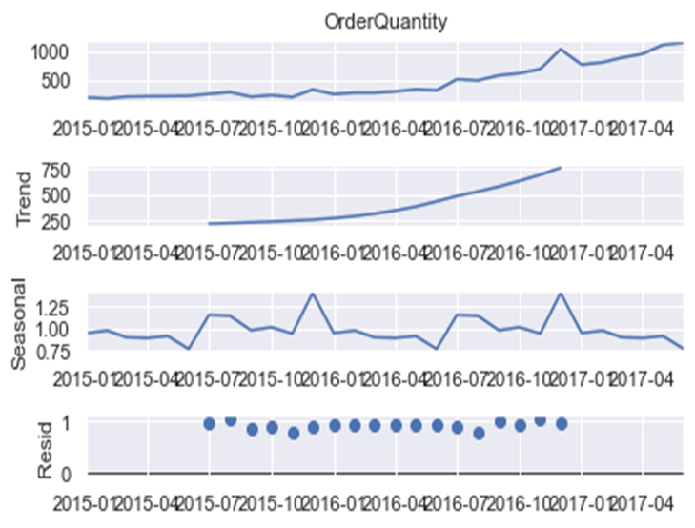
HYPOTHESIS 3: SALES ARE HIGHER FOR CERTAIN PRODUCT CATEGORIES DUE TO SEASONAL TRENDS
Using a seasonal decomposition method, we did a time series analysis focusing on the ‘Order Quantity’ variable.
The first observation is the raw time series data for the Order Quantity. It shows the overall trend and any fluctuations in sales quantity over time. We can see a sharp upward spike after Oct 2016 which normalizes by Jan 2017.
The plot shows a generally increasing trend 2015 to mid 2017, meaning that the sales quantities are growing.
The second observation which indicates the trend captures the long-term direction in the data, without the seasonal and outlier effects.
The trend is clearly upward especially after Jan 2016, indicating that the underlying sales quantity is increasing steadily. This suggests that demand for the products is growing over the observed period irrespective of season or other factors.

Slide 9

CONT’D; HYPOTHESIS 3: SALES ARE HIGHER FOR CERTAIN PRODUCT CATEGORIES DUE TO SEASONAL TRENDS
The third observation is the Seasonal component which indicates recurring patterns or fluctuations that occur at regular intervals. The plot shows that seasonal variation exists and is relatively small and consistent, with the patterns fluctuating mostly between about 0.75to 1.25.
The plot also shows that there are certain recurring periods where sales are above or below the baseline but the peaks and troughs shown aren’t overly dramatic.
Most of the peak sales occur around the last quarter of the year while the least sales occur in the second quarter of the year.
Generally, it can be inferred that the seasonality is not very strong. This suggests that the seasonal fluctuation in sales are not extreme.
The last plot is the Residual component which represents what is left after removing the trend and seasonal component. This essentially is the unpredictable, random fluctuations left in the data.
The residuals appear to be fairly low and close to zero, indicating that there are few extreme deviations in sales that cannot be explained by the trend and seasonal components.

Slide 10
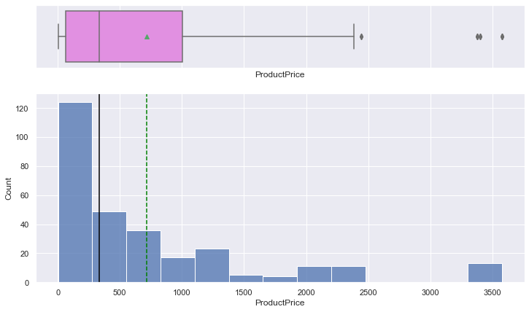
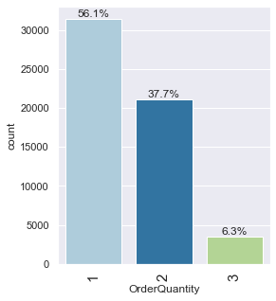
OBSERVATION
Price range is between 0 to $3800, with most of the products have prices between 0 and $1000
The mean product price is $714, while the median is much lower $333.42. This is as result of a few high price outliers influencing the mean value
Generally, products with very low prices have very high sales quantity
56.1% of orders where for a single product, 37.7% ordered 2 products are a time, while 6.3% had 3 products at a time

Slide 11
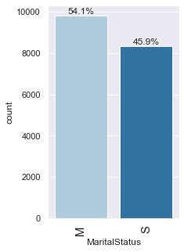
STATISTICAL ANALYSIS TO DETERMINE HOW MUCH ORDER QUANTITY IS INFLUENCED BY OTHER CUSTOMER CATEGORIES
 | F-Statistic | P-Value
Occupation | 8.106882763605723 | 1.57e-06
Gender | 5.293129706071907 | 5.03e-03
Marital Status | 24.612117889501132 | 7.03e-07
This result suggests that only ‘Marital Status’ influences Order Quantity mildly. The other customer categories do not have any significant influence on the sales quantity.

Slide 12
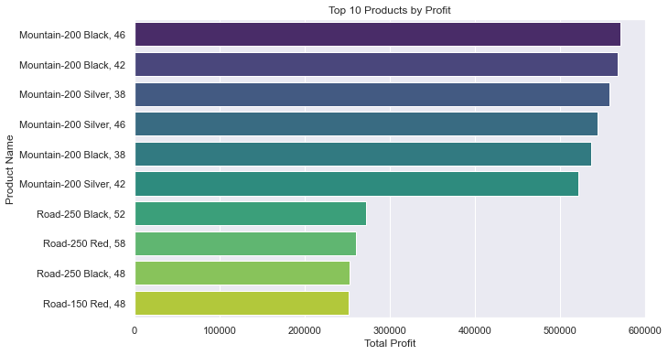
These are the top 10 profit generating products
They are all mountain bikes and road bikes
The various bikes generate more profit

Slide 13
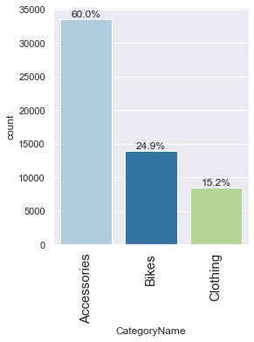
Category Name | Order Quantity | Revenue | Profit
Accessories | 57809 | 906,656.6 | 569,767.46
Bikes | 13929 | 23,642,500.0 | 9,726,169.08
Clothing | 12436 | 365,427.0 | 161,799.99
Components | 0 | 0 | 0
OBSERVATION
There are 4 categories of products in the database, the Accessories Category being the most popular in terms of order quantity
The Bikes category has the highest revenue as well as profit even as the quantity ordered is relatively low
There are 0 orders for the components products in the category name

Slide 14
ANALYZING SALES by subcategory
OBSERVATION
These are the 10 best selling subcategories
Subcategories such as ‘Tires and Tubes’ and ‘Bottles and Cages’ have low prices , hence the revenues do not reflect the high quantities sold
Road Bikes, Mountain Bikes and Touring Bikes have the highest revenues
Subcategory Name | Quantity | Revenue | Product Price
Tires and Tubes | 29772 | 380826.68 | 14.2
Bottles and Cages | 15106 | 107744.9 | 7.1
Road Bikes | 7099 | 11287182.6 | 1590
Helmets | 6034 | 205833.94 | 34.1
Mountain Bikes | 4706 | 8583747.74 | 1824
Caps | 4151 | 35882.07 | 8.6
Fenders | 3960 | 87040.8 | 22
Jerseys | 3113 | 158564.9 | 51
Gloves | 2644 | 62261.18 | 23.5
Touring Bikes | 2124 | 3771564.6 | 1775.7

Slide 15
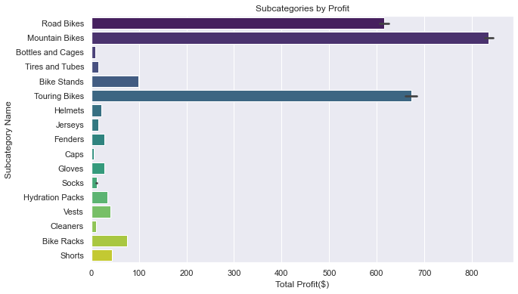
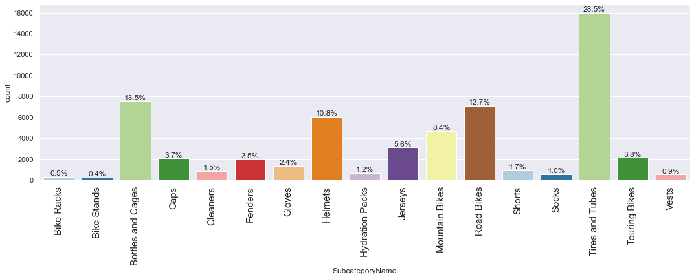
More charts showing a measure of the Subcategories by order quantity and also by profit

Slide 16
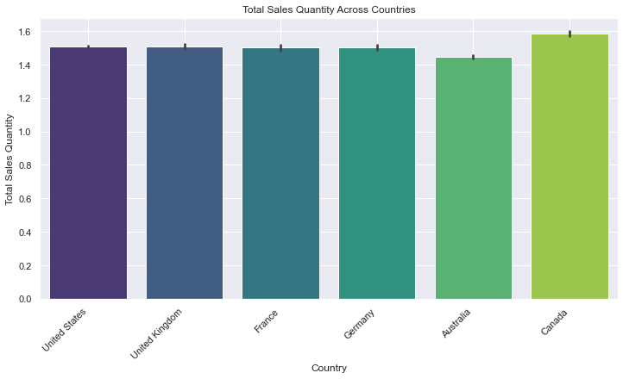
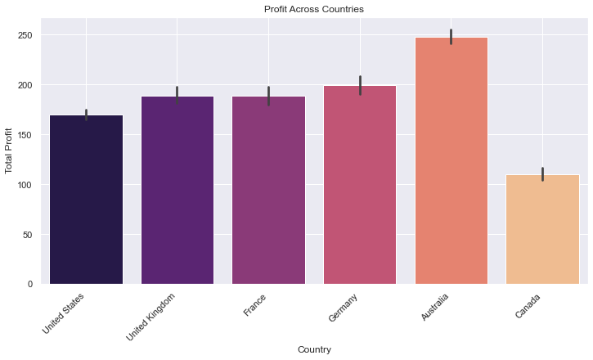
ANALYZING SALES DATA BY COUNTRY
From the above charts, we can see that can Canada though having the highest sales quantity, generates relatively low profit for the business
Australia is the favorite market for the business currently

Slide 17
ANALYZING SALES BY REGION
Australia generates the most revenue by region while Southeast, Northeast and Central America generate the least
The Component category generate zero sales while the Bikes category generates the most sales

Slide 18
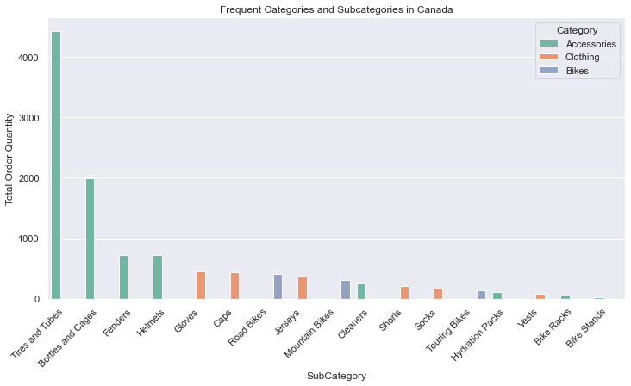
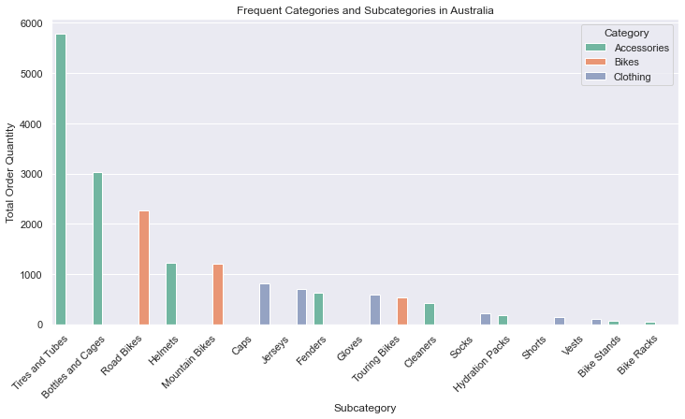
comparing SALES in Canada AND Australia
A further review of the Australian and Canadian territory shows that in Canada, products like bikes which have high returns, have very low sales quantity
The Australian market has more robust sales, with high priced products like bikes having much better order quantities

Slide 19
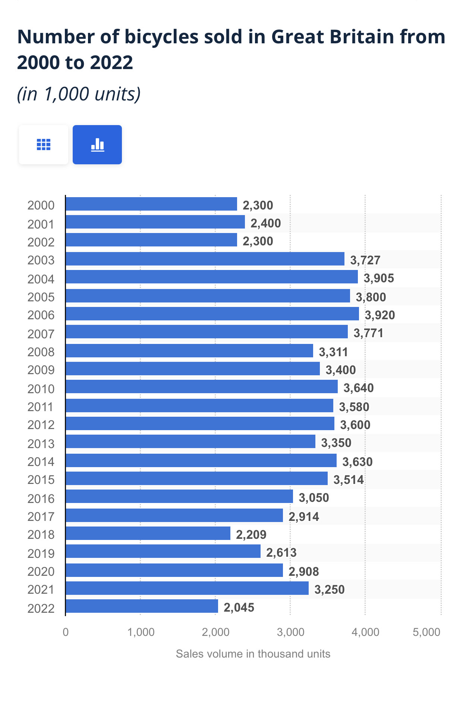
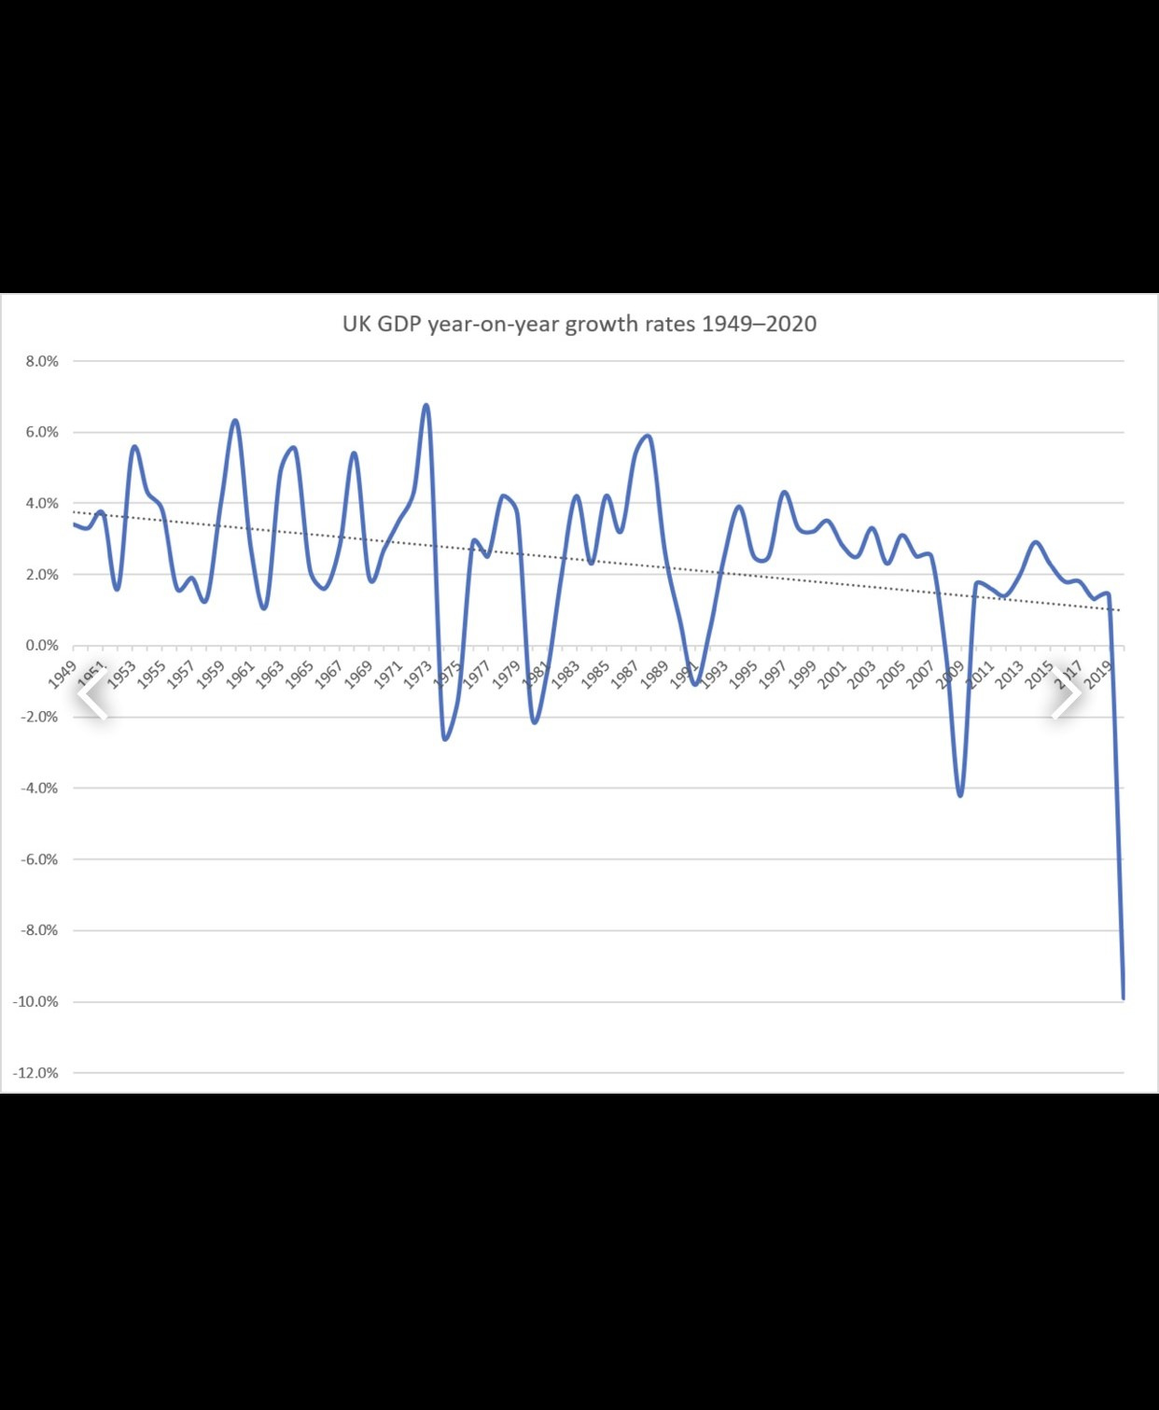
A quick look at the charts above gives an insight into the volatile nature of the GDP of the UK between 2015 to 2017 and how this economic condition could have brought about the a decline in customer spending confidence, leading to decline in sales of bicycles around that period
Sources; Statista.com and Wikipedia

Slide 20
Canada's Economic Context (2015-2017): During this period, Canada's economy was recovering from the global decline in oil prices, which had started in mid-2014. The sharp fall in oil prices led to a significant downturn in the country's oil and gas sector, contributing to weak GDP growth in 2015, particularly in provinces like Alberta that are heavily reliant on energy. Despite this, the Canadian economy began regaining momentum by 2016-2017, but consumer confidence remained fragile. Household investment also slowed, reflecting cautious spending, which likely influenced sales, particularly in high-priced goods like road bikes​.
Australia's Economic Context (2015-2017): In contrast, Australia's economic conditions were relatively stable during this period, supported by its mining sector and a robust housing market. Although Australia also felt the effects of lower global commodity prices, its diversified economy, with stronger retail and housing sectors, helped maintain consumer spending. Additionally, high-income growth and household wealth supported the purchase of more expensive products. As a result, Australians were more likely to invest in high-end products like road bikes during this period​.
SOURCES
1. https://www.budget.canada.ca/2016/docs/plan/overview-apercu-en.html
2. https://www.fraserinstitute.org/sites/default/files/analysis-economic-performance-of-canada-and-oecd-competitors-2007-2019.pdf
3. Australian Bureau of Statistics; www.abs.gov.au
4. Reserve Bank of Australia; www.rba.gov.au

Slide 21
OTHER POSSIBLE FACTORS
Retail and Market Availability
Canada: The business seems to have less availability of high-end products like road bikes probably due to higher import taxes and distribution costs. Limited access to high-end bike retailers could also contribute to lower sales in these regions.
Australia: Australia may have had better access to high-end bike retailers, both online and offline. Additionally, the presence of cycling events and sponsorships in Australia may have promoted the sale of high-priced bikes as opposed to countries like Canada
Geography and lifestyle:
Australia:
Weather: Australia, with its relatively mild climate in many regions, offers favorable year-round conditions for outdoor activities, including cycling. This makes it a more appealing market for high-end bikes like road bikes, as they can be used for longer periods.
Active Lifestyle: Australia has a strong outdoor culture, with a focus on fitness and recreational activities, and cycling is a popular hobby. This aligns well with the demand for high-end bikes, which are seen not just as a means of transport but also as a lifestyle investment.

Slide 22
Canada:
Weather: Canada’s climate can be quite harsh, with long winters, especially in parts of the country where outdoor recreational activities like cycling are limited to only certain months of the year. This would have limited the appeal of investing in high-priced bikes for many Canadians.
Urbanization: Canada has large, urbanized cities but also vast rural areas. Cycling infrastructure is not as developed as in some European countries, and only certain parts of Canada, such as Vancouver and Toronto, are known for having bike-friendly environments, which may limit demand for expensive road bikes.

Slide 23
INSIGHTS AND RECOMMENDATIONS
A significant volume of sales comes from low-priced products while most of the business revenue comes from high-priced products.
Sales are generally on the increase irrespective of other influences. This is can most likely be associated with more spending power and so more adverts recommending products are advised so as to get across to fresh customers who can afford a newly afford products
Products under the components category should not be restocked as they make zero sales
The Southeast and Northeast America stores should be closed to reduce cost as they make little or no sales due to inevitable factors such as infrastructural, geographical and climatic influences.
A marketing strategy involving price reduction and more availability of high-priced products should be targeted towards territories where sales are slower.

